Slide 1
Apache Kafka Streaming
Pravin Y Pawar

Slide 2
Streaming Platform
Features
A streaming platform has three key capabilities:
Publish and subscribe to streams of records, similar to a message queue or enterprise messaging system
Store streams of records in a fault-tolerant durable way
Process streams of records as they occur

Slide 3
Apache Kafka
Distributed pub-sub and queuing messaging system
Designed for high throughput distributed systems
Better throughput
In-built partitioning mechanism
Replicas
Fault Tolerant
Good fit for large scale data processing
Suitable for both offline and online message transfer
Messages are persisted on disk and replicated across cluster to prevent message loss
Integrate with Storm and Spark easily

Slide 4
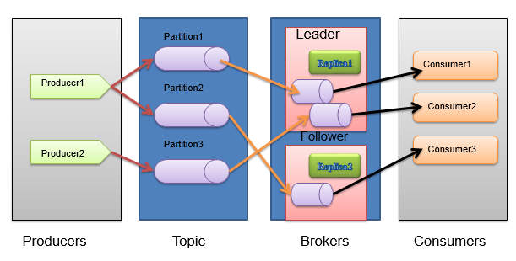
Kafka Fundamentals
Kafka Architecture

Slide 5
Kafka Concepts
Kafka is run as a cluster on one or more servers that can span multiple datacenters.
The Kafka cluster stores streams of records in categories called topics.
Each record consists of a key, a value, and a timestamp.

Slide 6
Kafka APIs
The Producer API
allows an application to publish a stream of records to one or more Kafka topics.
The Consumer API
allows an application to subscribe to one or more topics and process the stream of records produced to them.
The Streams API
allows an application to act as a stream processor, consuming an input stream from one or more topics and producing an output stream to one or more output topics, effectively transforming the input streams to output streams.
The Connector API
allows building and running reusable producers or consumers that connect Kafka topics to existing applications or data systems. For example, a connector to a relational database might capture every change to a table.

Slide 7
Kafka for Stream Processing
It isn't enough to just read, write, and store streams of data, the purpose is to enable real-time processing of streams.
In Kafka a stream processor is anything that
takes continual streams of data from input topics
performs some processing on this input
produces continual streams of data to output topics
For example, a retail application might take in input streams of sales and shipments, and output a stream of reorders and price adjustments computed off this data.
It is possible to do simple processing directly using the producer and consumer APIs. However for more complex transformations Kafka provides a fully integrated Streams API.
The streams API builds on the core primitives Kafka provides
it uses the producer and consumer APIs for input
uses Kafka for stateful storage
uses the same group mechanism for fault tolerance among the stream processor instances

Slide 8
Kafka Streams API
Can build highly scalable, elastic, distributed, and fault-tolerant application
Provides Stateful and stateless processing
Can perform Event-time processing with windowing, joins, and aggregations
Can use the already-defined most common transformation operation using Kafka Streams DSL or the lower-level processor API, which allow us to define and connect custom processors
Low barrier to entry
does not take much configuration and setup to run a small scale trial of stream processing; the rest depends on your use case
No separate cluster requirements for processing (integrated with Kafka)
Employs one-record-at-a-time processing to achieve millisecond processing latency
supports event-time based windowing operations with the late arrival of records.
Supports Kafka Connect to connect to different applications and databases.

Slide 9
Stream Processing Topology
A stream
is the most important abstraction provided by Kafka Streams
represents an unbounded, continuously updating data set
is an ordered, replayable, and fault-tolerant sequence of immutable data records, where a data record is defined as a key-value pair.
A stream processing application
is any program that makes use of the Kafka Streams library
defines its computational logic through one or more processor topologies, where a processor topology is a graph of stream processors (nodes) that are connected by streams (edges).
A stream processor
is a node in the processor topology
represents a processing step
to transform data in streams by receiving one input record at a time from its upstream processors in the topology
applying its operation to it
may subsequently produce one or more output records to its downstream processors

Slide 10
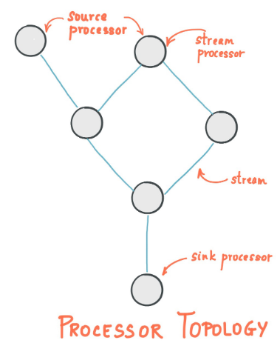
Kafka Stream Processors
Source Processor
is a special type of stream processor that does not have any
upstream processors
produces an input stream to its topology from one or multiple
Kafka topics by consuming records from these topics and forwarding
them to its down-stream processors
Sink Processor
is a special type of stream processor that does not have down-stream
processors
sends any received records from its up-stream processors to a
specified Kafka topic

Slide 11
Processing in Kafka Streams
Two options available for processing stream data:
High-level Kafka Streams DSL
A lower-level processor that provides APIs for data-processing, composable processing, and local state storage

Slide 12
Processing in Kafka Streams(2)
High-Level DSL
Has already implemented methods ready to use
Composed of two main abstractions: KStream and KTable or GlobalKTable.
KStream
is an abstraction of record stream where each data is a simple key value pair in the unbounded dataset
provides us many functional ways to manipulate stream data like
map
mapValue
flatMap
flatMapValues
filter
provides joining methods for joining multiple streams and aggregation methods on stream data
KTable or GlobalKTable
is an abstraction of a changelog stream
every data record is considered an Insert or Update (Upsert) depending upon the existence of the key as any existing row with the same key will be overwritten

Slide 13
Processing in Kafka Streams(3)
Processor API
The low-level Processor API
provides a client to access stream data
to perform our business logic on the incoming data stream
send the result as the downstream data
allows extending the abstract class AbstractProcessor and overriding the process method which contains our logic
this process method is called once for every key-value pair
The high-level DSL provides ready to use methods with functional style
The low-level processor API provides you the flexibility to implement processing logic according to your need
The trade-off is just the lines of code you need to write for specific scenarios

Slide 14
Thank You!
In our next session: Streaming Data Concepts and Usage

